Slide 1
Study on Arduino Uno & Initialization of Smart Home

Slide 2
Developed by…
Soham Das D202105453
Sounava Ghosh D202105456
Debjit Mitra D202105432
Tanmoy Bag D202105470
Shuvankar Dhara D202105450
Under the guidance & supervision of
ARIJIT DEY [lecturer]

Slide 3
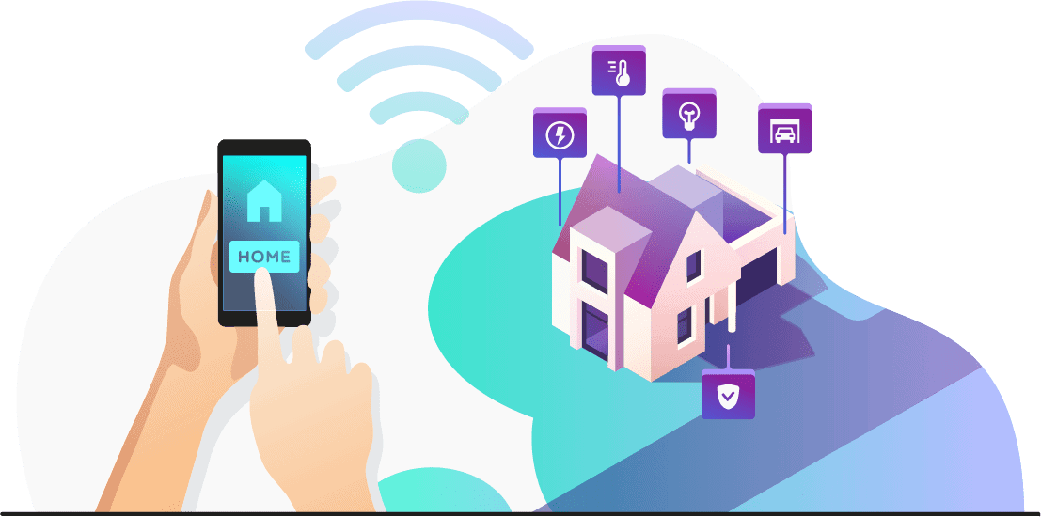
Initialization of Smart Home
In our project on the Arduino UNO board, we brought the concept of IOT devices.
We used the help of RemoteXY platform to implement this with the help of ESP-01 in relation with the Arduino UNO to establish connection between the user, IOT platform (RemoteXY) and the hardware we will be controlling with it.

Slide 4
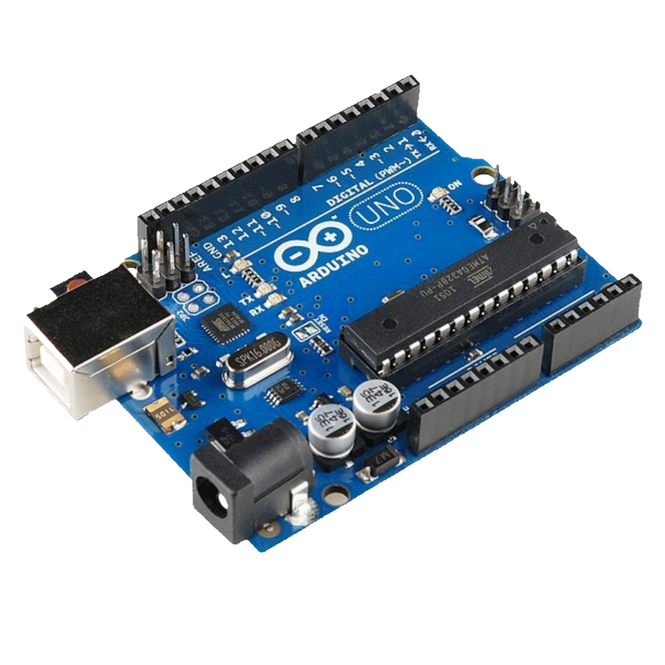
Arduino UNO
Introduction
Arduino Uno is an open source electronics platform based on easy-to-use hardware and software. It’s intended for anyone making interactive projects.
Arduino senses the environment by receiving inputs from many sensors, and affects its surroundings by controlling lights, motors, and other actuators. You can tell your Arduino what to do by writing code in the Arduino programming language (based on Wiring) and using the Arduino development environment.

Slide 5
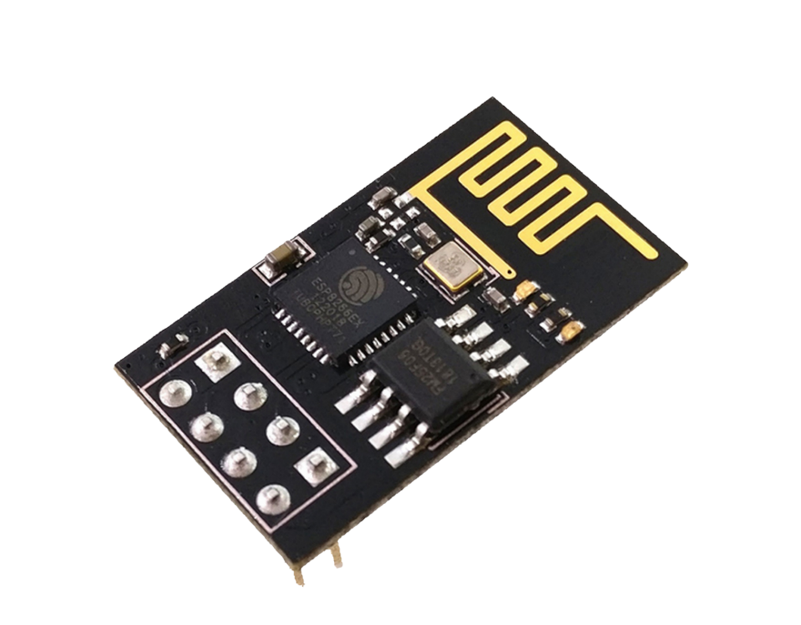
ESP-01 802.11 b/g/n Wi-Fi Module
Introduction
The ESP-01 (ESP8266) was one of the first low-cost microcontrollers with Wi-Fi connectivity. It has since been replaced by newer versions with more GPIOs, more memory, and more power.
It is a Wi-Fi module that allows microcontrollers access to a Wi-Fi network. This module is a self-contained SOC (System on a Chip) that doesn’t necessarily need a microcontroller to manipulate inputs and outputs as you would normally do with an Arduino

Slide 6

RemoteXY
Introduction
RemoteXY is a website that allows you to easily build a phone interface that will talk to your hardware over Bluetooth LE, USB, or Ethernet (including Wi-Fi). One thing of interest: even though the interface builder is Web-based, the service claims that the interface structure stays on the controller.
There’s no interaction with the remote servers when operating the user interface so there is no need for an external Internet connection.

Slide 7
Projects
Operating Led Bulb(240V)using Arduino UNO via relay using ESP-01.
Operating DC motor using Arduino and ESP-01.
Controlling 240V Bulb.
Controlling DC motor.
Arduino & ESP-01

Slide 8
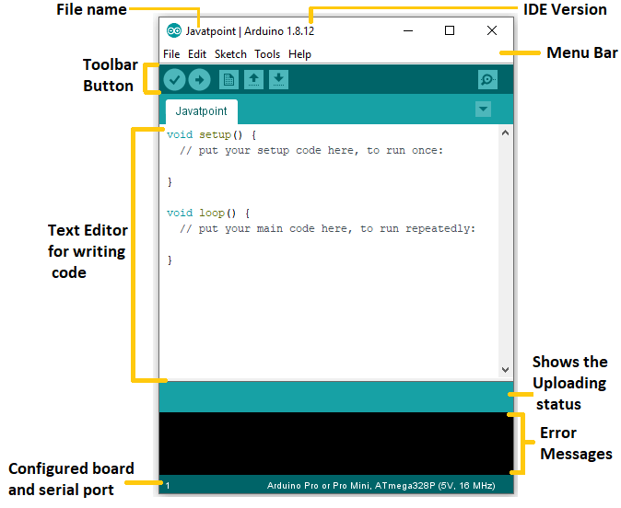
Arduino IDE
The Arduino Integrated Development Environment - or Arduino Software (IDE) - contains a text editor for writing code, a message area, a text console, a toolbar with buttons for common functions and a series of menus. It connects to the Arduino hardware to upload programs and communicate with them.

Slide 9
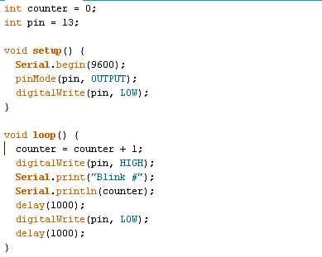
Arduino Sketch
The Arduino programming language is based on Processing, which is aimed at visual artists. Hence a development version being a 'sketch'. "Processing is a programming language, development environment, and online community that since 2001 has promoted software literacy within the visual arts.

Slide 10

Sketch:-
// RemoteXY select connection mode and include library
#define REMOTEXY_MODE__ESP8266_HARDSERIAL
#include <RemoteXY.h>
// RemoteXY connection settings
#define REMOTEXY_SERIAL Serial
#define REMOTEXY_SERIAL_SPEED 115200
#define REMOTEXY_WIFI_SSID "Debjitroxx“
#define REMOTEXY_WIFI_PASSWORD "12345678“
#define REMOTEXY_SERVER_PORT 6377
#define REMOTEXY_ACCESS_PASSWORD "arduino“
// RemoteXY configurate
#pragma pack(push, 1)
uint8_t RemoteXY_CONF[] = // 298 bytes

Slide 11
Sketch:-
{ 255,9,0,0,0,35,1,16,24,1,2,0,42,11,13,5,2,26,31,31, 79,78,0,79,70,70,0,4,192,25,77,36,5,120,0,4,192,25,85,36, 5,120,0,4,192,25,93,36,5,120,0,4,192,25,69,36,5,120,0,2, 0,42,48,13,5,2,26,31,31,79,78,0,79,70,70,0,2,0,42,30, 13,5,2,26,31,31,79,78,0,79,70,70,0,2,0,42,39,13,5,2, 26,31,31,79,78,0,79,70,70,0,2,0,42,20,13,5,2,26,31,31, 79,78,0,79,70,70,0,129,0,4,49,14,3,2,66,97,116,104,114,111, 111,109,0,129,0,4,12,13,3,2,66,101,100,114,111,111,109,0,129,0, 4,30,9,3,2,68,105,110,105,110,103,0,129,0,4,40,11,3,2,75, 105,116,99,104,101,110,0,129,0,4,21,16,3,2,66,101,100,114,111,111, 109,32,50,0,129,0,26,3,12,4,2,76,105,103,104,116,115,0,129,0, 27,60,9,4,121,70,97,110,115,0,130,1,244,56,78,1,26,129,0,4, 70,13,3,121,66,101,100,114,111,111,109,0,129,0,4,78,16,3,121,66, 101,100,114,111,111,109,32,50,0,129,0,4,86,9,3,121,68,105,110,105, 110,103,0,129,0,4,94,11,3,121,75,105,116,99,104,101,110,0 };
// this structure defines all the variables and events of your control interface
struct {

Slide 12
Sketch:-
// input variables
uint8_t switch_1; // =1 if switch ON and =0 if OFF
int8_t slider_2; // =0..100 slider position
int8_t slider_3; // =0..100 slider position
int8_t slider_4; // =0..100 slider position
int8_t slider_1; // =0..100 slider position
uint8_t switch_5; // =1 if switch ON and =0 if OFF
uint8_t switch_3; // =1 if switch ON and =0 if OFF
uint8_t switch_4; // =1 if switch ON and =0 if OFF
uint8_t switch_2; // =1 if switch ON and =0 if OFF
// other variable
uint8_t connect_flag; // =1 if wire connected, else =0
} RemoteXY;
#pragma pack(pop)
#define PIN_SWITCH_1 2
#define PIN_SWITCH_5 12
#define PIN_SWITCH_3 7

Slide 13
Sketch:-
#define PIN_SWITCH_4 8
#define PIN_SWITCH_2 4
void setup()
{
RemoteXY_Init ();
pinMode (PIN_SWITCH_1, OUTPUT);
pinMode (PIN_SWITCH_5, OUTPUT);
pinMode (PIN_SWITCH_3, OUTPUT);
pinMode (PIN_SWITCH_4, OUTPUT);
pinMode (PIN_SWITCH_2, OUTPUT);
// TODO you setup code
}

Slide 14
Sketch:-
void loop()
{
RemoteXY_Handler ();
digitalWrite(PIN_SWITCH_1, (RemoteXY.switch_1==0)?HIGH:LOW); digitalWrite(PIN_SWITCH_5, (RemoteXY.switch_5==0)?LOW:HIGH); digitalWrite(PIN_SWITCH_3, (RemoteXY.switch_3==0)?HIGH:LOW); digitalWrite(PIN_SWITCH_4, (RemoteXY.switch_4==0)?HIGH:LOW); digitalWrite(PIN_SWITCH_2, (RemoteXY.switch_2==0)?HIGH:LOW);
int MotorSpeed1 = RemoteXY.slider_1 * 2.5 ;
analogWrite(3,MotorSpeed1);
int MotorSpeed2 = RemoteXY.slider_2 * 2.5 ;
analogWrite(5,MotorSpeed2);
int MotorSpeed3 = RemoteXY.slider_3 * 2.5 ;
analogWrite(6,MotorSpeed3);
int MotorSpeed4 = RemoteXY.slider_4 * 2.5 ;
analogWrite(9,MotorSpeed4);

Slide 15
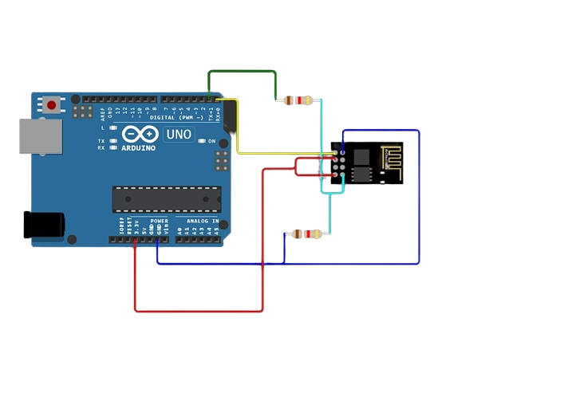
Controlling Motor & Led Using Arduino with the help of
Wi-Fi module.
_{5.00v}-
Connection: -
Note: We have to perform the previous * * connections.
RX Pin of Arduino Uno connected to TX port of ESP-01
TX in Arduino Uno connected to RX port of ESP-01 through 1k resistor
3.3v port in Arduino Uno connected to 3.3v pin in ESP-01 to power it
GND port in Arduino Uno connected to GND port in ESP-01
RX pin of ESP-01 is connected to GND with a 2k resistor

Slide 16
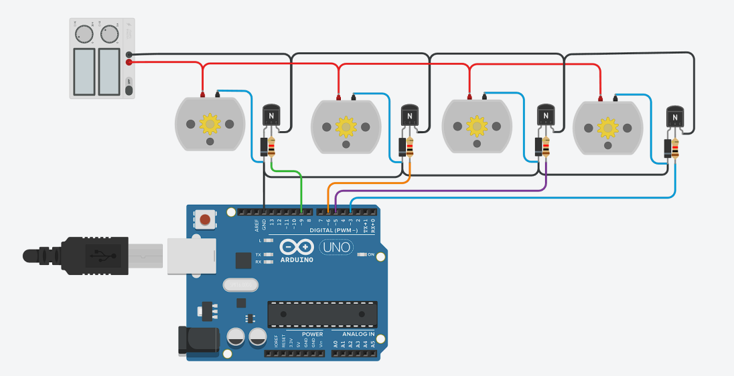
Controlling Motor & Led Using Arduino with the help of
Wi-Fi module.
_{5.00v}-
Connection: -
Connect one end of the resistor to Pin 9 as an input.
Connect the other end of the resistor to the middle Pin (Base) of the transistor
Connect Collector of the transistor to the Anode of the diode
Connect Cathode of diode to the GND Pin of the Arduino
Connect the Cathode of diode to Positive 5V of the supply
Connect the positive 5V of supply to the dc motor positive pin
Connect the negative 5V of supply to the Emitter of the Transistor
Connect the negative dc motor pin to the anode of the diode
Repeat the same steps 1-8 using pins 6,5 & 3 as an input .

Slide 17
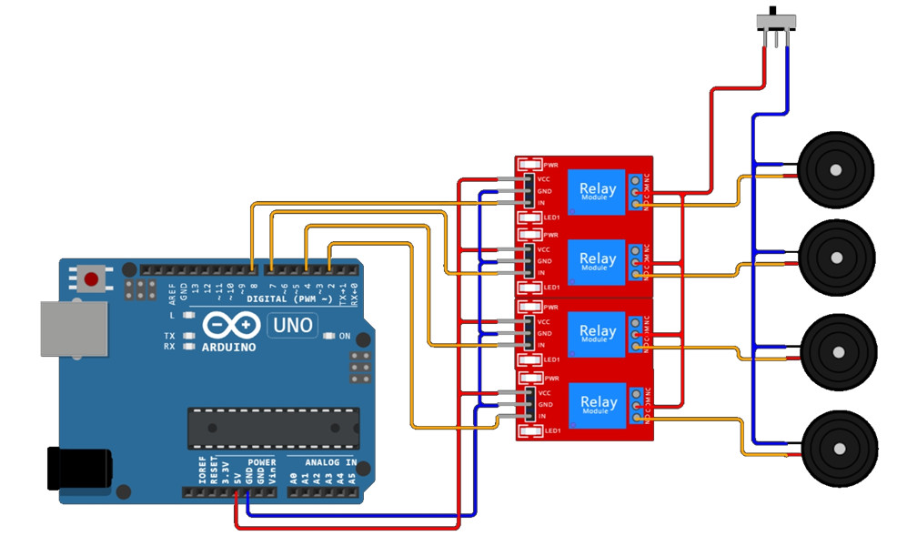
Operating 240V LED Bulb using Relay & Arduino UNO
Connection: -
Connect Pin 8 to relay as an input.
Connect VCC of relay to the 5V supply of Arduino.
Connect GND of relay to GND of Arduino.
Connect the output of the relay to a bulb .
Repeat the same steps 1-5 using pins 2, 4 & 7 as an input .

Slide 18
Application on Home Automation
Energy Management.
Security.
Lighting Control.
Appliance Control.
Voice Assistant.
Water Management.
Home Maintenance.
Emergency Response.

Slide 19
Advantage on Home Automation
Energy Efficiency.
Cost Savings.
Security.
Safety.
Remote Monitoring.
Customization and Personalization.
Accessibility.
Time Savings.
Health and Wellness.
Reduced Wasted Resources.

Slide 20
Future Scope on Home Automation
Interconnectivity and Integration.
5G and Connectivity.
Artificial Intelligence (AI) and Machine Learning.
Predictive Analytics.
Smart Cities Integration.
Advanced Voice and Gesture Control.

Slide 21
End Thank You

